Slide 1
DI-322 Web Technologies
Introduction: Web Applications
TCP/IP Application Services

Slide 2
1. Web Applications:
Definition: Web applications are software applications that run on web servers and are accessed by users over a network, typically the internet, through a web browser.

Slide 3
1. Web Applications:
Components of a Web Application:
Client-side scripting: The code that executes in the user's browser. Typically written in languages like HTML, CSS, and JavaScript.
Server-side scripting: The code that executes on the server. It handles requests from clients, interacts with databases, and generates dynamic content. Common server-side scripting languages include PHP, Python, Ruby, and Java.
Database: Web applications often interact with databases to store and retrieve data. Common databases include MySQL, PostgreSQL, MongoDB, etc.
Web Server: The server that hosts the web application and serves web pages to clients. Popular web servers include Apache, Nginx, and Microsoft IIS.

Slide 4
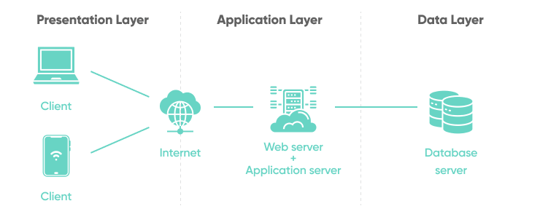
1. Web Applications:

Slide 5
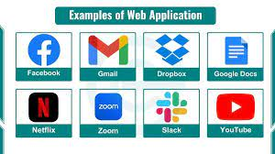
1. Web Applications:
Types of Web Applications:
Static Web Applications: Content remains fixed and does not change unless manually updated.
Dynamic Web Applications: Content is generated dynamically based on user input, interactions, or other external factors.
Examples of Web Applications:
Social media platforms like Facebook, Twitter
E-commerce websites like Amazon, eBay
Productivity tools like Google Docs
Online banking systems
Web-based email services like Gmail, Outlook

Slide 6
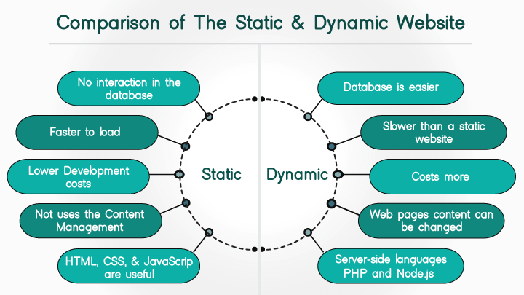
1. Web Applications:

Slide 7
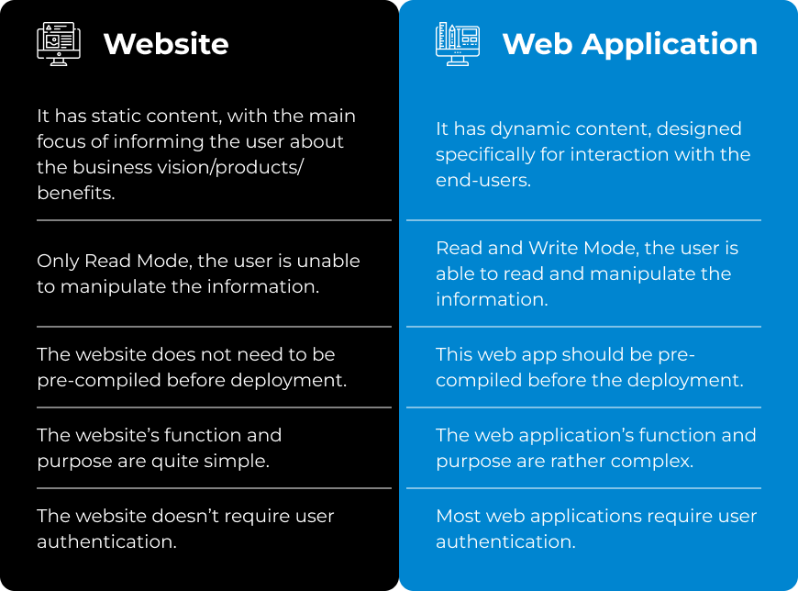
1. Web Applications:

Slide 8
1. Web Applications:
Protocols for Running Web Applications:
a. Hypertext Transfer Protocol (HTTP):
Description: HTTP is the foundation of data communication on the World Wide Web. It defines how messages are formatted and transmitted between web servers and clients.
Usage: HTTP is used by web browsers to request web pages from servers and by servers to send responses back to clients. It supports various methods such as GET, POST, PUT, DELETE, etc., for different types of interactions.
b. Secure Hypertext Transfer Protocol (HTTPS):
Description: HTTPS is an extension of HTTP that adds a layer of encryption using SSL/TLS protocols to secure data transmission between clients and servers.
Usage: HTTPS is essential for securing sensitive information transmitted over the internet, such as login credentials, payment details

Slide 9
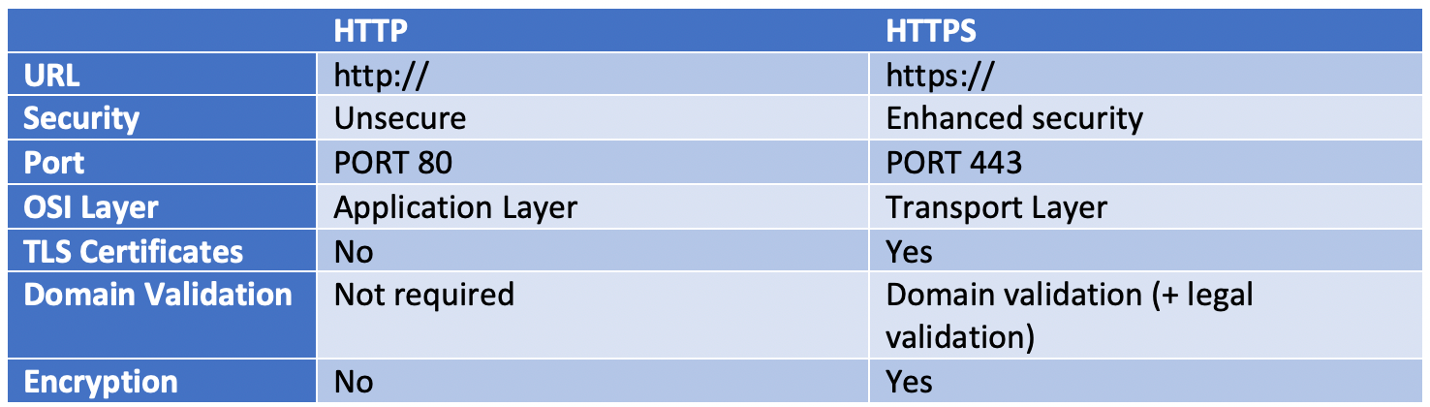
1. Web Applications:

Slide 10
2. TCP/IP Application Services:
TCP/IP Protocol Suite:
Transmission Control Protocol (TCP): Provides reliable, connection-oriented communication between applications.
Internet Protocol (IP): Routes data packets across networks and provides addressing and routing functions.
Application Layer Protocols: Protocols that operate at the highest layer of the TCP/IP model and enable communication between applications.

Slide 11
2. TCP/IP Application Services:
Common TCP/IP Application Layer Protocols and services:
Hypertext Transfer Protocol (HTTP): Used for transferring hypertext documents on the World Wide Web.
File Transfer Protocol (FTP): Used for transferring files between a client and a server on a computer network.
Simple Mail Transfer Protocol (SMTP): Used for sending email messages between servers.
Post Office Protocol (POP3) and Internet Message Access Protocol (IMAP): Used by email clients to retrieve emails from a mail server.
Domain Name System (DNS): Translates domain names into IP addresses, enabling users to access websites using human-readable addresses.

